Slide 1
LITHIUM BATTERY SYSTEMS - METHODOLOGY TO DESIGN BATTERY PACKS
Dr. RVGK Sarma
Consultant
16/01/2020

Slide 2
Advantages of Lithium
Lightest Metal
High electro Negativity
High energy Density

Slide 3
LITHIUM SYSTEMS
  Lithium Iron Phosphate – LFP
  Lithium Nickel-Cobalt – Aluminium – NCA
  Lithium Nickel –Manganese – Cobalt – NMC
  Lithium Titanate – LTO
  Lithium Manganese Spine - LMO

Slide 4
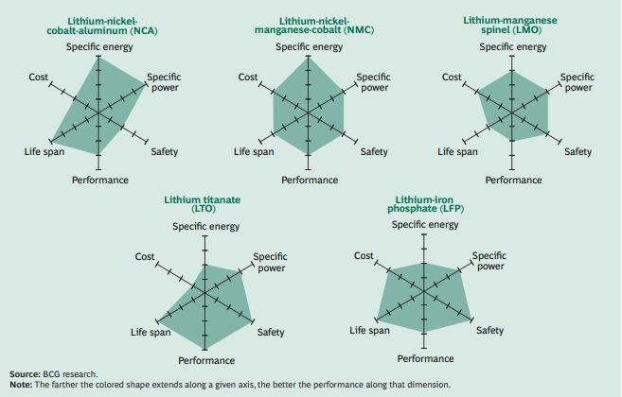
MAJOR LITHIUM SYSTEMS

Slide 5
MANUFACTURERS
Samsung SDI
LG Chem
Valence Technologies
Johnson Controls ( JCI)
SONY
Panasonic
Kokam
BYD
CITL

Slide 6
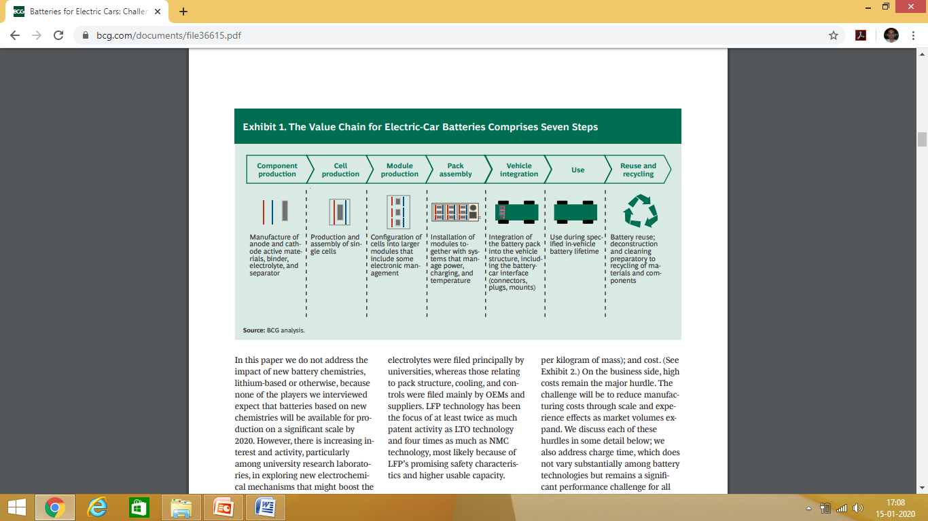
TYPICAL VALUE CHAIN IN EV

Slide 7
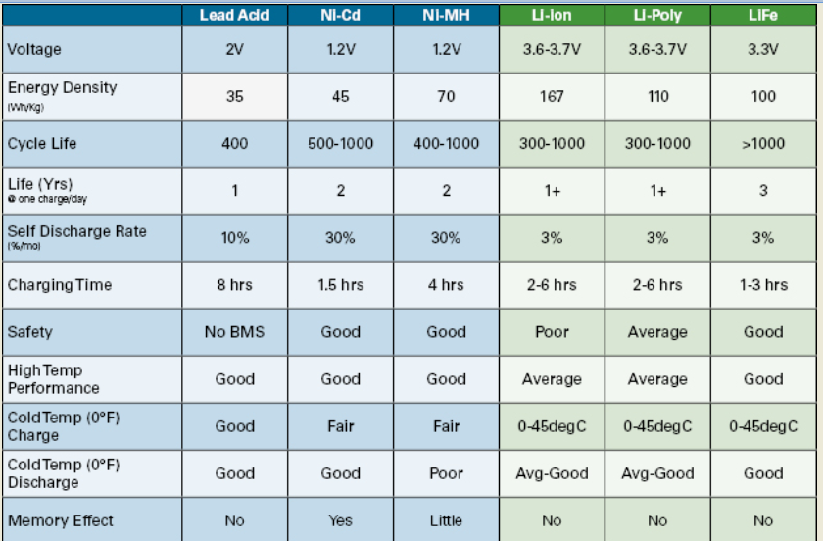

Slide 8
What to consider
Safety
Life Span
  Cycle Stability
  Overall Age
Performance
  Peak Power at Low Temperatures
  State of Charge Measurement
  Thermal Management
Specific energy and Specific Power
Charging Time
Usable Capacity and mark up
Costs

Slide 9
Pack Assembly
Good Quality Cells
Cell Level protection
  CID Current Interrupt Device
  PTC Positive Temperature Coefficient
Various combinations are possible based on Pack Voltage and Capacity
Fitment - Dimensions

Slide 10
Choice of Cells
Cell Chemistry
Cell Capacities – 100%
100% of cells are to be sorted out for capacities and grouped in various bands
100% checking of OCV and grouping in various bands

Slide 11
Open Circuit Voltage
Very Important Criteria
Cells are to be grouped in 0.02Volts bands
Example
    3.89 – 3.91 Volts
    3.91 – 3.93 Volts

Slide 12
Internal Resistance
All Cells should be measured for internal resistance – Automatic Set up
All cells are to be sorted on value of IR
Cells are to be grouped again depending on OCV
Typical Values of IR will be 30-50 milli Ohms for LFP 18650 Cells

Slide 13
Design
Typical 18650 Cell Design
  Choice of cells based on application viz., EV, Power or Digital
  Typical thickness of electrodes very from 0.110 mm to 0.150 mm
  Cell Assembly typically automatic in climate controlled rooms

Slide 14
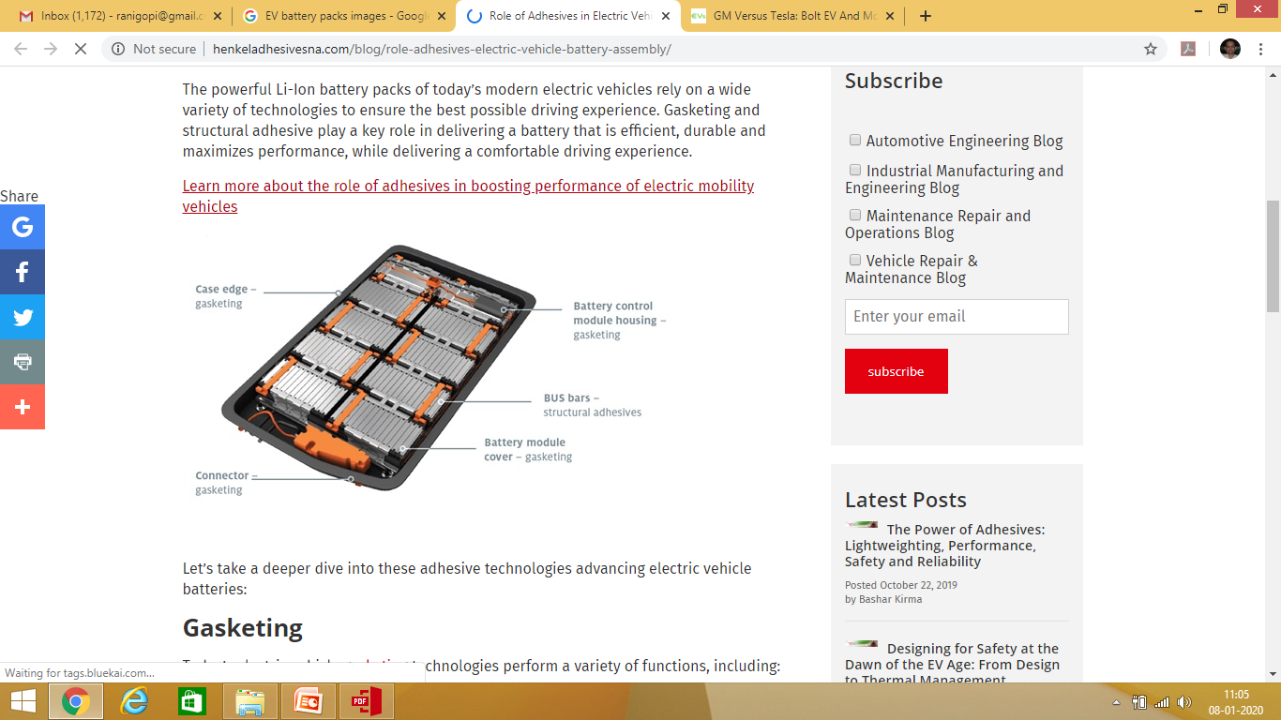
Typical Picture of EV Pack

Slide 15
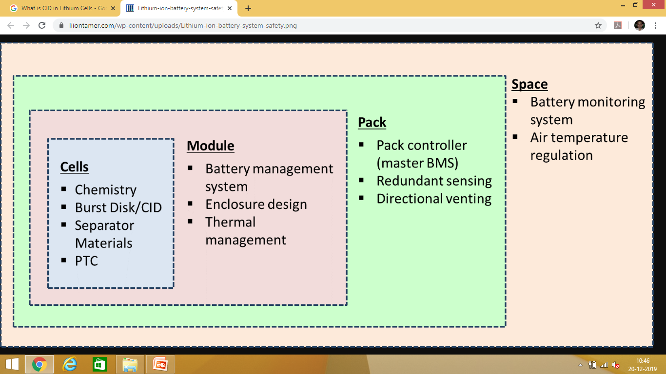
Lithium Ion Safety Mechanism

Slide 16
Battery Management System
Sensing and high-voltage control: Measure voltage, current, temperature; control contactor, pre-charge; ground-fault detection, thermal management.
Protection against: Over-charge, over-discharge, over-current, short circuit, extreme temperatures.
Interface: Range estimation, communications, data recording, reporting.
Performance management: State-of-charge (SOC) estimation, power-limit computation, balance/equalize cells.
Diagnostics: Abuse detection, state-of-health (SOH) estimation, state-of-life (SOL) estimation.

Slide 17
Pack testing
Capacity of Pack
Insulation Resistance
Function of BMS
Balance of Packs/Cells
Charging Efficiency
Temperature

Slide 18
Indian Scenario - Challenges
Availability of Lithium
Economics of ownership of EV
Cells are entirely imported – mainly from China
No cell manufacturing facility
Charging infrastructure – Availability of Power
Disposal of old batteries
Environmental issues
Cost of replacement Pack

